Slide 1
Array.
Storing data in JavaScript.

Slide 2
Objectives
Define array.
Demonstrate creating arrays.
Practice mutating arrays.
Utilize resources provided to further understanding of arrays.

Slide 3
What is an array
An indexed collection of variables that can have different data types

Slide 4
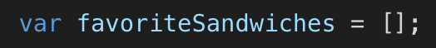
Create an empty Array
1. [ ] use square brackets (most common)
OR
2. Use new Array keyword

Slide 5
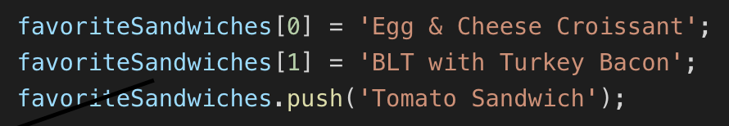
Add values to the Array
How would add values to the empty favoriteSandwiches array?

Slide 6
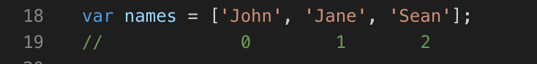
Create an Array with values
1. [ ] use square brackets (most common)
OR
2. Use new Array keyword

Slide 7
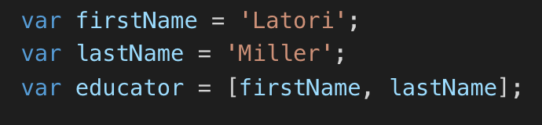
Use variables inside arrays

Slide 8
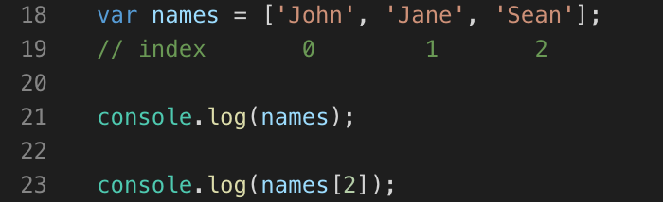
Accessing Arrays
Uses the variable and
Use the variable
index with brackets
Console output:

Slide 9
Challenge #1
Open up VS code…
Create an array named noNewFriends
Include your name and the names of the people seated at your table
Use the index of your name and the .length the array to console.log the number of people that sit at your table and your name in a sentence.
e.g. Tori has 2 friends at her table.

Slide 10
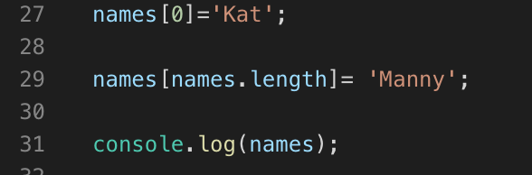
Mutate Data in Array
Very simple to change the data in an array
Before
After

Slide 11
Methods available to Arrays
.join() – combines items of an array and lets you specify the characters in between items
.push() - adds an element to the end of an array
.unshift() - adds an element to the beginning
.pop() - removes the last element
.shift() - removes the first element
.indexOf( ) - returns the position of the element if it
IS PRESENT in the array, if it is not returns -1

Slide 12
Challenge #2
Create a conditional statement that checks if the name ‘Drake’ is present in the noNewFriends array.
If he is present console.log
‘No New Friends! Drake, we’re going to have to ask you to leave.’
If not, console.log ‘R2H Rocks!’
Practice using methods with arrays that are new to you

Slide 13
Challenge #3
Add ‘Drake’ to the end of your noNewFriends array
Create a conditional statement that checks if ‘Drake’ is present
If he is present use a method to remove him from the array
If he is not present console.log ‘R2H Rocks!’

Slide 14

Are we on point?

Slide 15
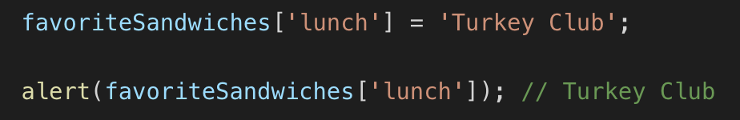
Associate Arrays
The index value is set to a string rather than the normal number value
Rarely used & some consider bad practice.

Slide 16
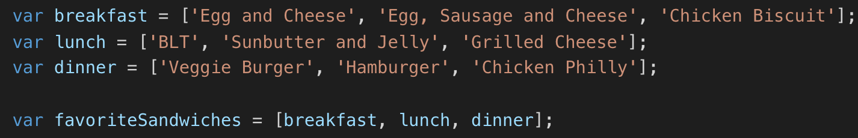
Multidimensional Array
Arrays of arrays of arrays …
You can add any kind of data to an array, even other arrays

Slide 17
Resources
MDN JavaScript Array Documentation
https://developer.mozilla.org/en-US/docs/Web/JavaScript/Reference/Global_Objects/Array
W3Schools JavaScript Arrays
https://www.w3schools.com/js/js_arrays.asp
Array Cardio Tutorial
https://javascript30.com/

